Slide 1
Cis-476 term project By: Athira Nakkara Radhakrishnan

Slide 2
MYPASS – TERM PROJECT
Tools and Technologies
Backend:
PHP
MySQL
Node.js
Frontend:
React
Axios
HTML
CSS
JavaScript
Other Tools:
npm
XAMPP
VS Code
Postman

Slide 3
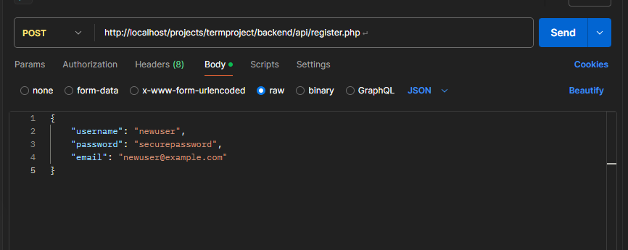
API Testing - Postman
API tests are done to ensure backend functionality with Postman

Slide 4
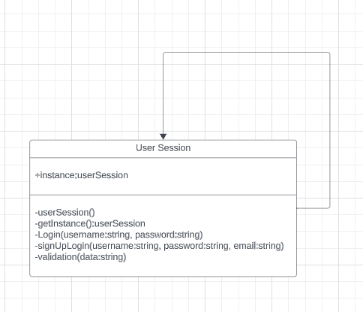
Login singleton session
• User Authentication and Encryption:
Implement the Singleton pattern to manage the user's session securely.

Slide 5
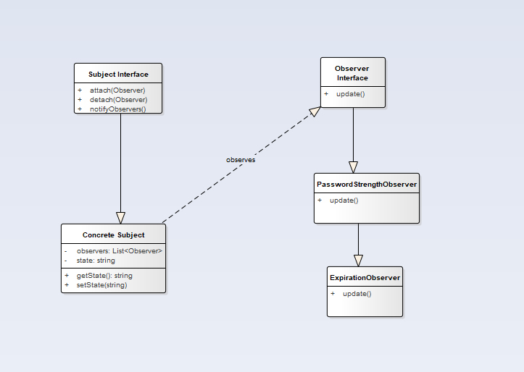
Password management
Password Storage and Management:
Apply the Observer pattern to notify users in the events of weak password, credit card expiration, passport expiration, license expiration, etc.

Slide 6
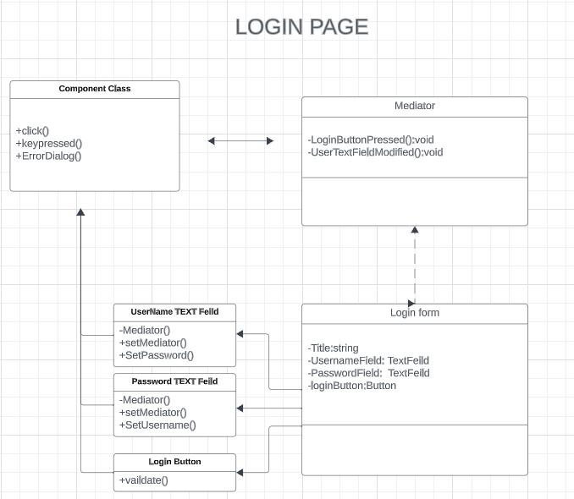
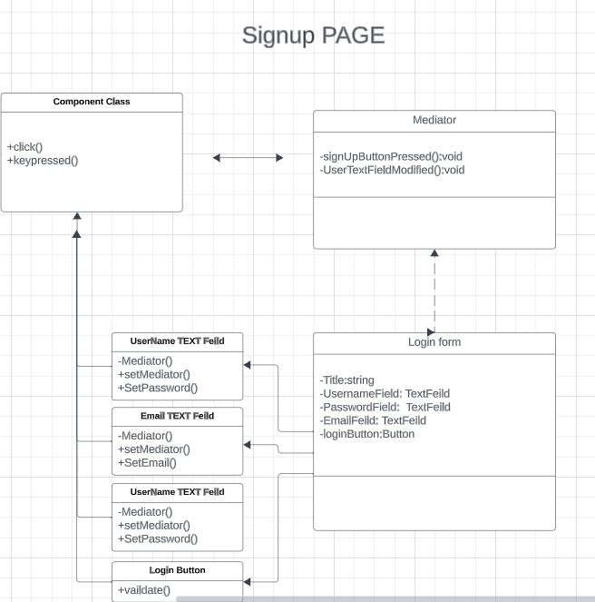
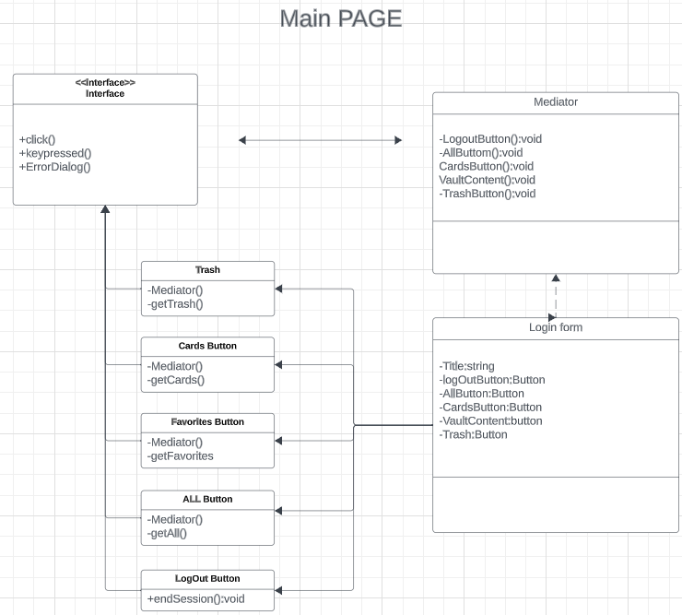
User InterFace and Interactions
Implement the Mediator pattern to manage communication between various UI components.

Slide 7
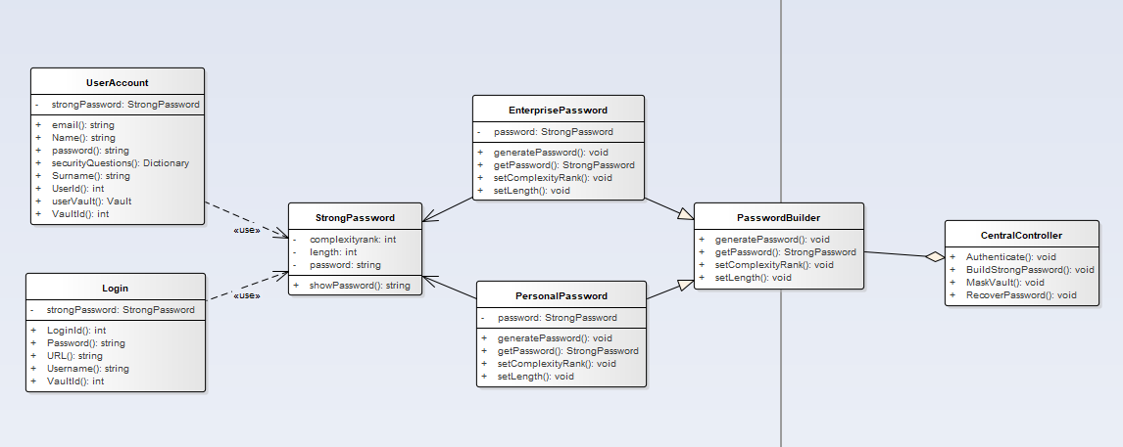
Password Generation
Apply the Builder pattern to create complex passwords with specific requirements (length, complexity).

Slide 8
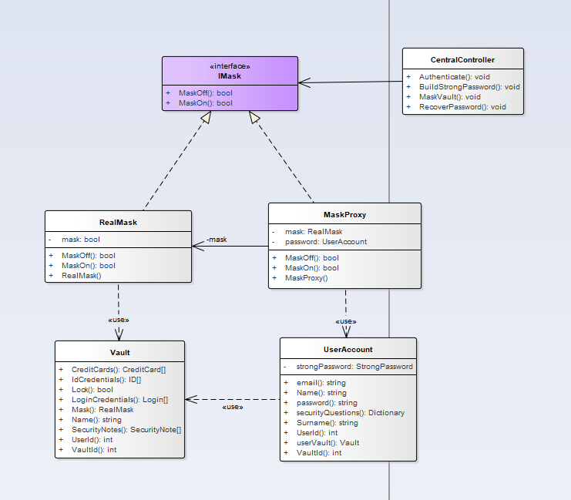
Data Mask and Unmask
Implement the Proxy pattern to mask and unmask sensitive data.

Slide 9
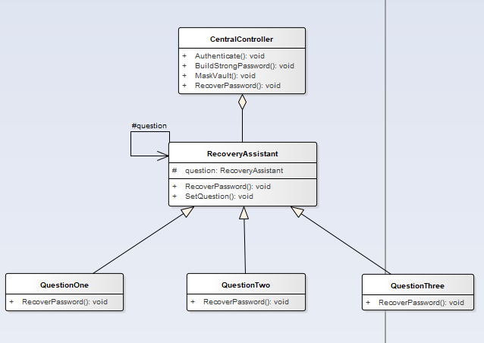
Master Password Recovery
Apply the Chain of Responsibility pattern to create a secure process (using three security questions to build the chain) for recovering a forgotten master password.

Slide 10
Database Schema
users Table
CREATE TABLE users (
id INT AUTO_INCREMENT PRIMARY KEY,
email VARCHAR(255) NOT NULL UNIQUE,
master_password_hash VARCHAR(255) NOT NULL,
security_question_1 TEXT NOT NULL,
security_question_2 TEXT NOT NULL,
security_question_3 TEXT NOT NULL,
security_answer_1_hash VARCHAR(255) NOT NULL,
security_answer_2_hash VARCHAR(255) NOT NULL,
security_answer_3_hash VARCHAR(255) NOT NULL,
created_at TIMESTAMP DEFAULT CURRENT_TIMESTAMP
);
Vault_items Table
CREATE TABLE vault (
id INT AUTO_INCREMENT PRIMARY KEY,
user_id INT NOT NULL,
item_type ENUM('Login', 'Credit Card', 'Identity', 'Secure Note') NOT NULL,
data TEXT NOT NULL,
created_at TIMESTAMP DEFAULT CURRENT_TIMESTAMP,
updated_at TIMESTAMP DEFAULT CURRENT_TIMESTAMP ON UPDATE CURRENT_TIMESTAMP,
FOREIGN KEY (user_id) REFERENCES users(id) ON DELETE CASCADE
);

Slide 11
Database Schema
clipboard_logs Table
CREATE TABLE clipboard_logs (
id INT AUTO_INCREMENT PRIMARY KEY,
user_id INT NOT NULL,
data_type ENUM('Login', 'Credit Card', 'Identity', 'Secure Notes') NOT NULL,
data_value TEXT NOT NULL,
copied_at TIMESTAMP DEFAULT CURRENT_TIMESTAMP,
expiration_time TIMESTAMP DEFAULT NULL,
FOREIGN KEY (user_id) REFERENCES users(id) ON DELETE CASCADE
);
activity_logs Table
CREATE TABLE activity_logs (
id INT AUTO_INCREMENT PRIMARY KEY,
user_id INT NOT NULL,
last_activity TIMESTAMP DEFAULT CURRENT_TIMESTAMP,
FOREIGN KEY (user_id) REFERENCES users(id) ON DELETE CASCADE
);

Slide 12
Live DEMO

Slide 13
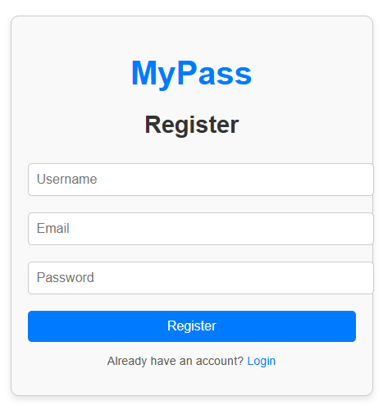
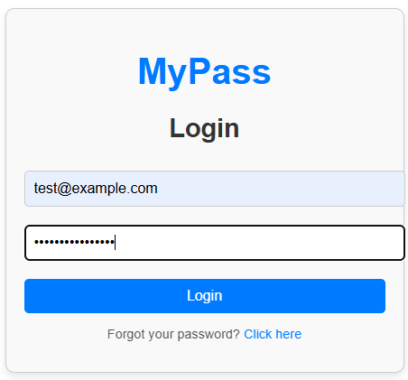

Slide 14
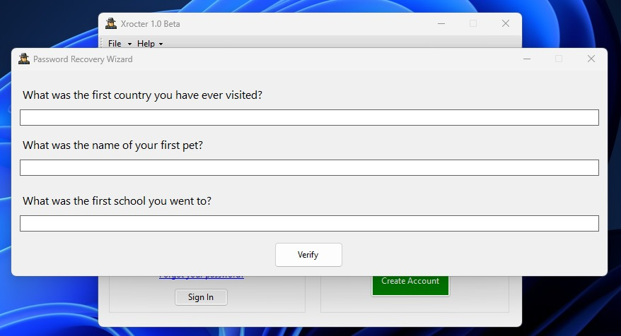
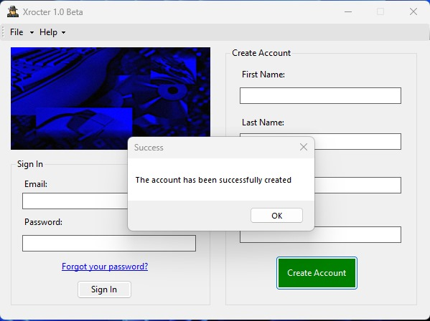

Slide 15
THANK YOU
Athira Nakkara Radhakrishnan

